Slide 1

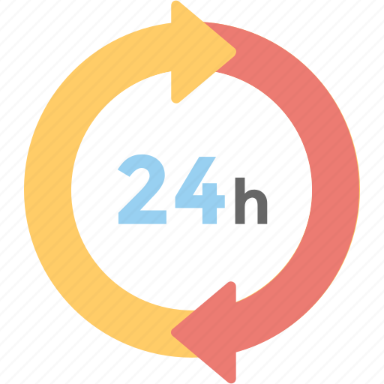
24-HOUR FORECAST
15-11-2022 @ 1200 UTC
Department of Meteorology and Climate Science,
KNUST

Slide 2
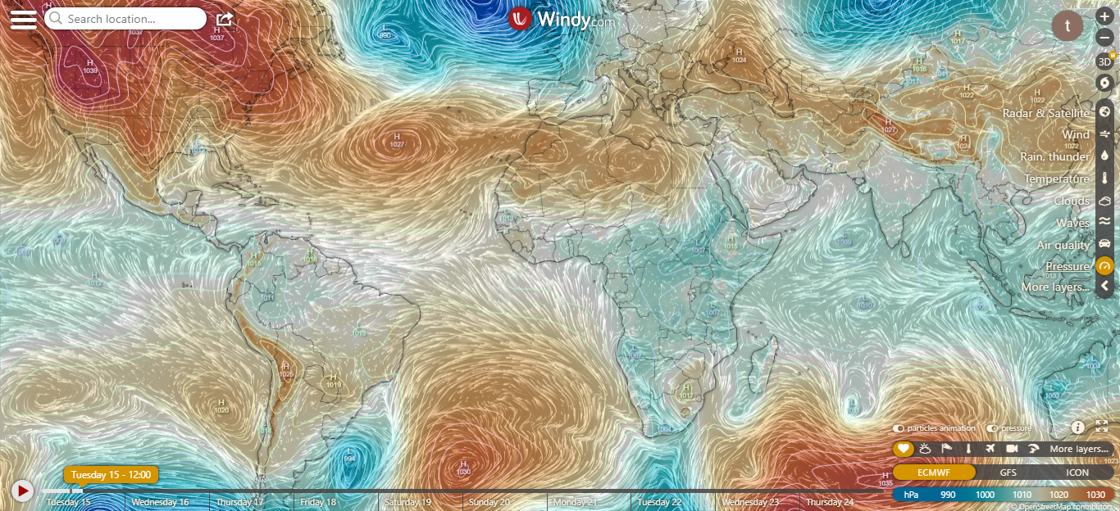
PRESSURE SYSTEMS @ 1200 UTC
1024hPa
1023hPa

Slide 3
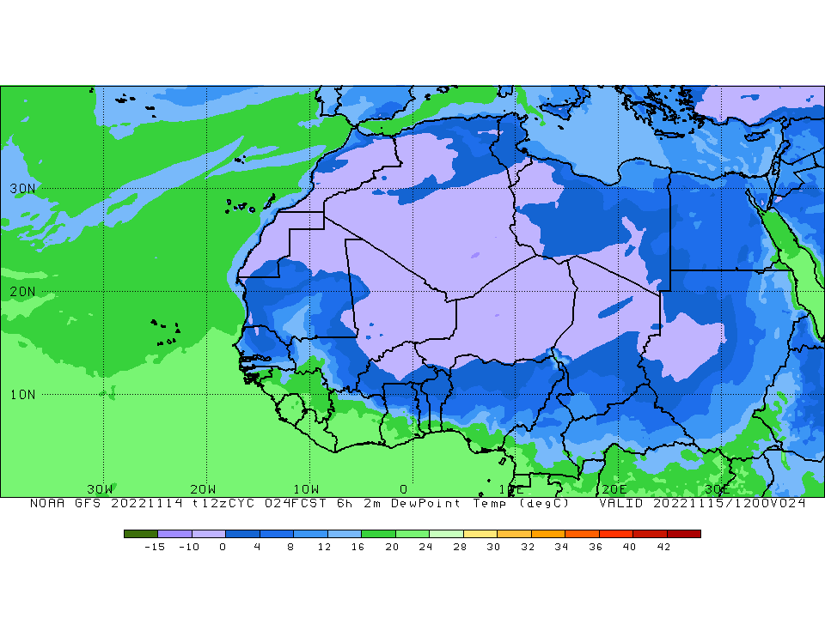
ITD POSITION @ 1200 UTC
7.0ºN

Slide 4
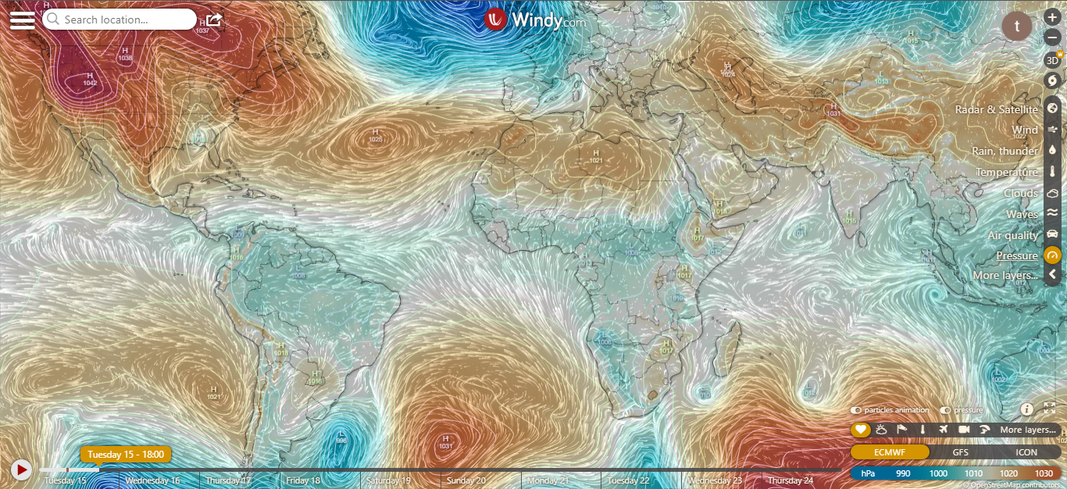
PRESSURE SYSTEMS @ 1800 UTC
1022hPa
1021hPa

Slide 5
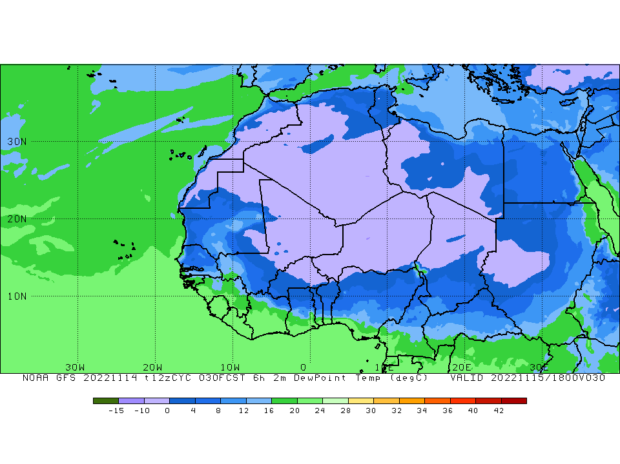
ITD POSITION @ 1800 UTC
6.8ºN

Slide 6
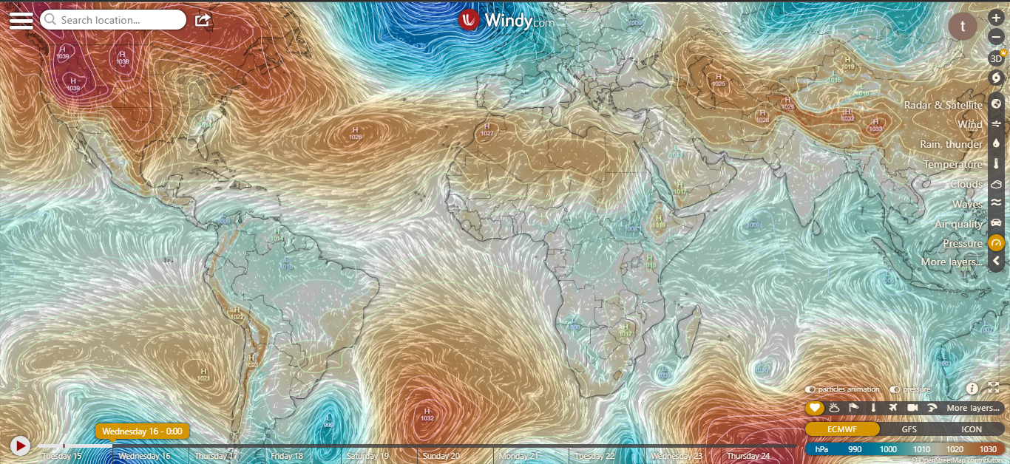
PRESSURE SYSTEMS @ 0000 UTC
1022hPa
1021hPa

Slide 7
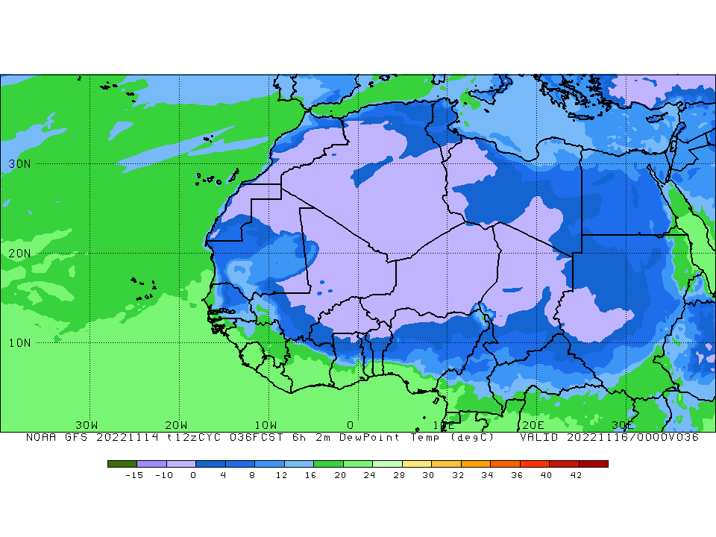
ITD POSITION @ 0000 UTC
6.7ºN

Slide 8
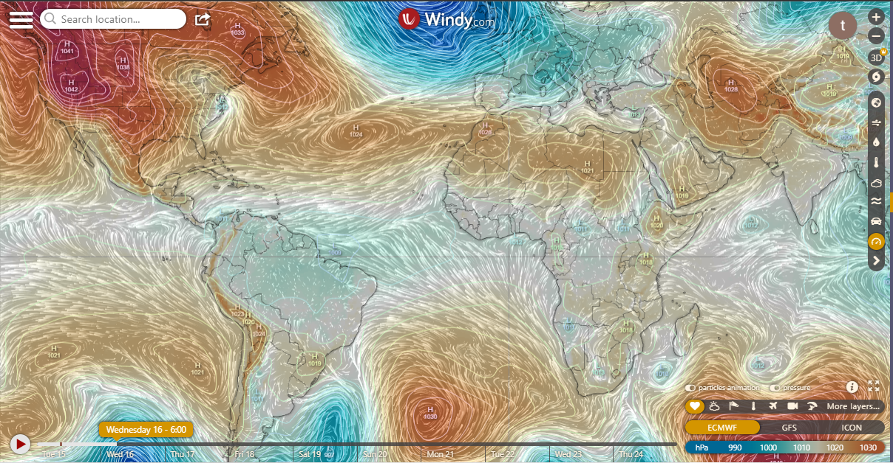
PRESSURE SYSTEMS @ 0600 UTC
1022hPa
1019hPa

Slide 9
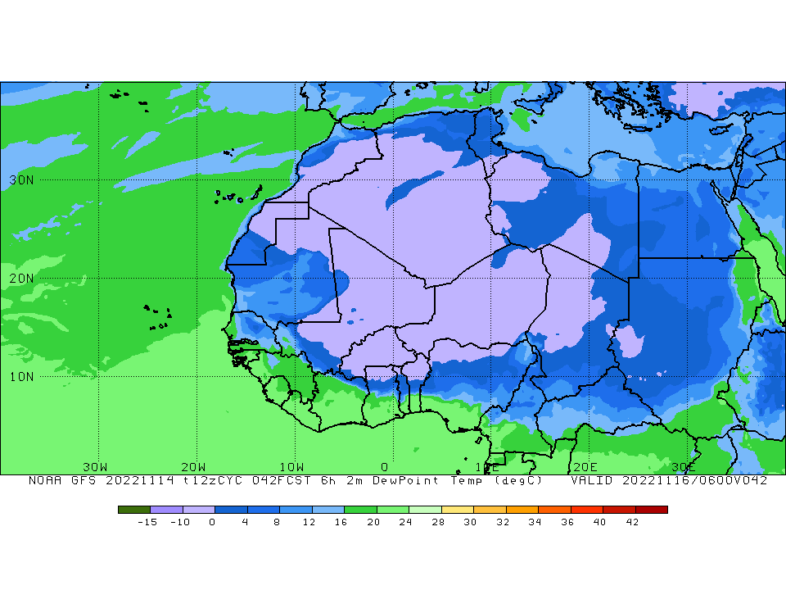
ITD POSITION @ 0600 UTC
7.0ºN

Slide 10
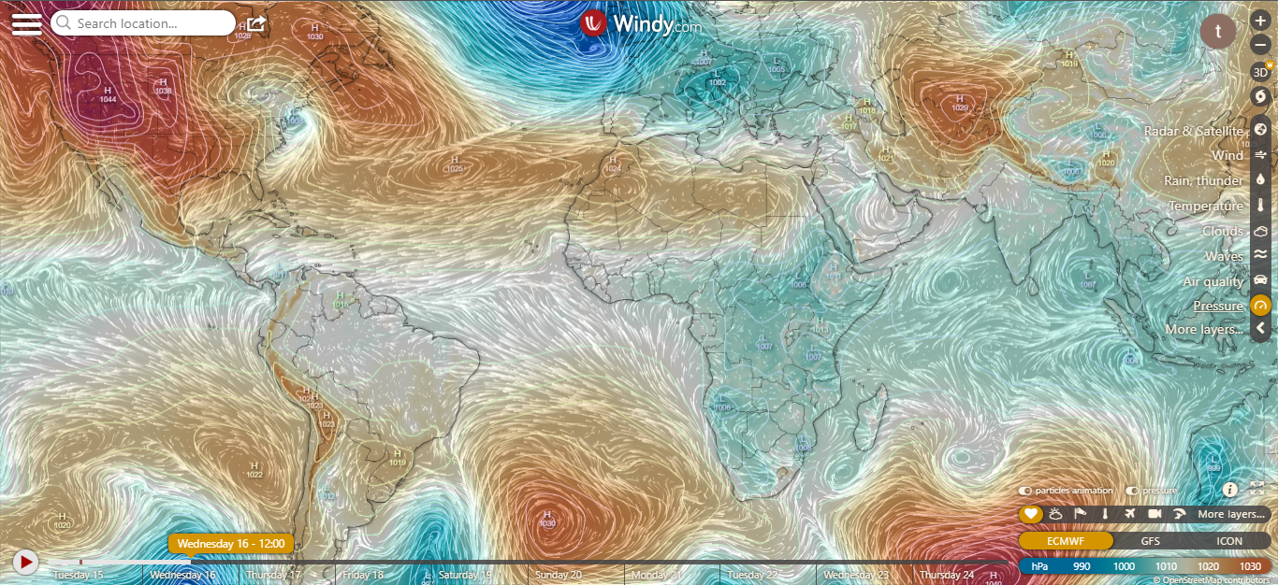
PRESSURE SYSTEMS @ 1200 UTC
1023hPa
1019hPa

Slide 11
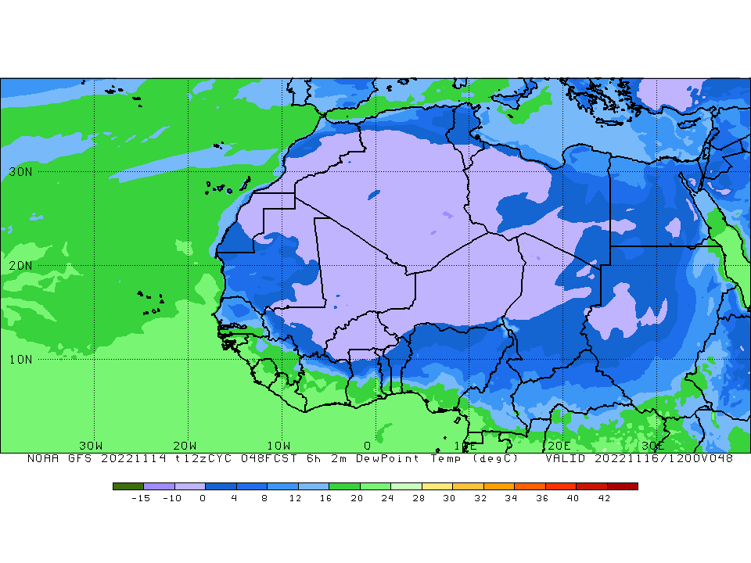
ITD POSITION @ 1200 UTC
6.8ºN

Slide 12
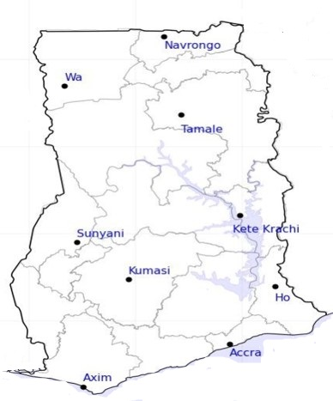

23
24-HOUR FORECAST
15-11-2022 @ 1200 UTC
18
RH AT DAY
[%]
36
36
68
70
69
62
79
80

Slide 13
24
24-HOUR FORECAST
15-11-2022 @ 1200 UTC
37
45
RH AT NIGHT
[%]
45
73
82
89
87
86
79

Slide 14
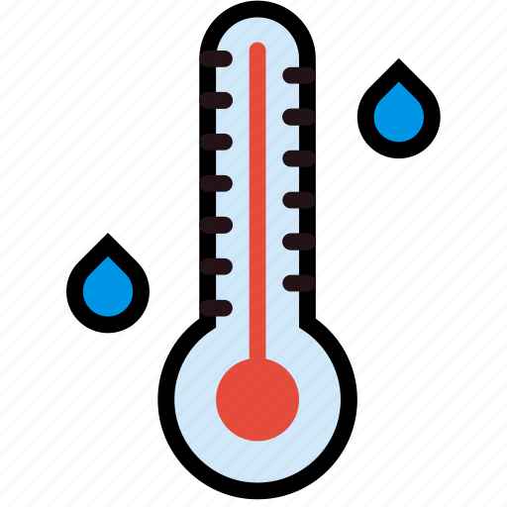




35
24-HOUR FORECAST
15-11-2022 @ 1200 UTC
3$4$
35
TEMPERATURE AT DAY [$℃$]
3$4$
31
31
31
29
2$8$
27

Slide 15



25
24-HOUR FORECAST
15-11-2022 @ 1200 UTC
24
TEMPERATURE AT NIGHT [$℃$]
24
$$25$$
24
28
$$24$$
25
26
26

Slide 16



GENERAL OUTLOOK
24-HOUR FORECAST
15-11-2022 @ 1200 UTC
Rain
Wind
Dust
PROBABILITY OF RAINS
-
Low risk
Be aware
Be Prepared
Take Action

Slide 17
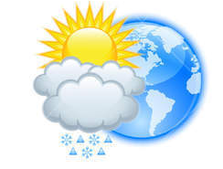


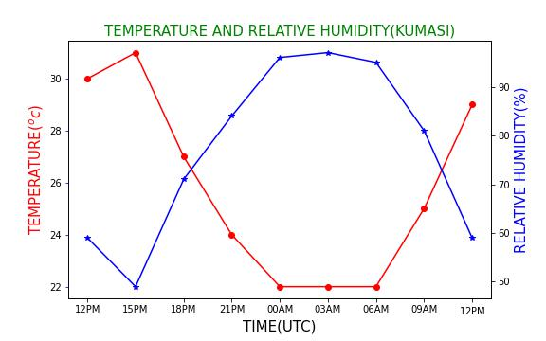


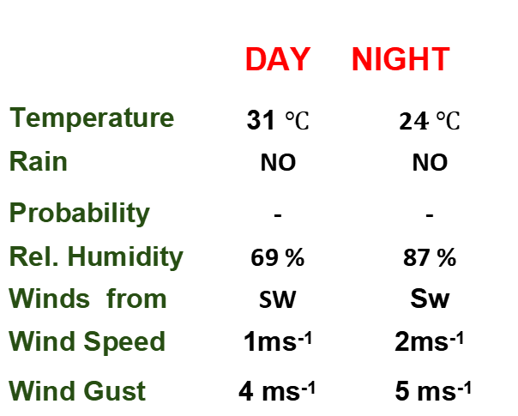
KNUST WEATHER FORECAST
24-HOUR FORECAST
15-11-2022 @ 1200 UTC
Rain
Wind
Dust
Forecast Summary (KUMASI)
 | DAY | NIGHT
Temperature | 31 $℃$ | 2$4 ℃$
Rain | NO | NO
Probability | - | -
Rel. Humidity | 69 % | 87 %
Winds from | SW | Sw
Wind Speed | 1ms⁻¹ | 2ms⁻¹
Wind Gust | 4 ms⁻¹ | 5 ms⁻¹
Low risk
Be aware
Be Prepared
Take Action
POWERED BY:
Department of Meteorology and Climate Science,
CoS
SUNSET: 05:47 PM SUNRISE: 05:57 AM

Slide 18


